Slide 1
2024 Completed Projects:
Sandblast and paint 300/400 front rails
Powerwash all buildings
Create a rock and mulch bed extension behind 400 bldg. to cover dead grass area
Powerwash and stain fence
Powerwash and stain 100/200 rear decks
Replaced rotted railroad ties
Paint Doors Red

Slide 2
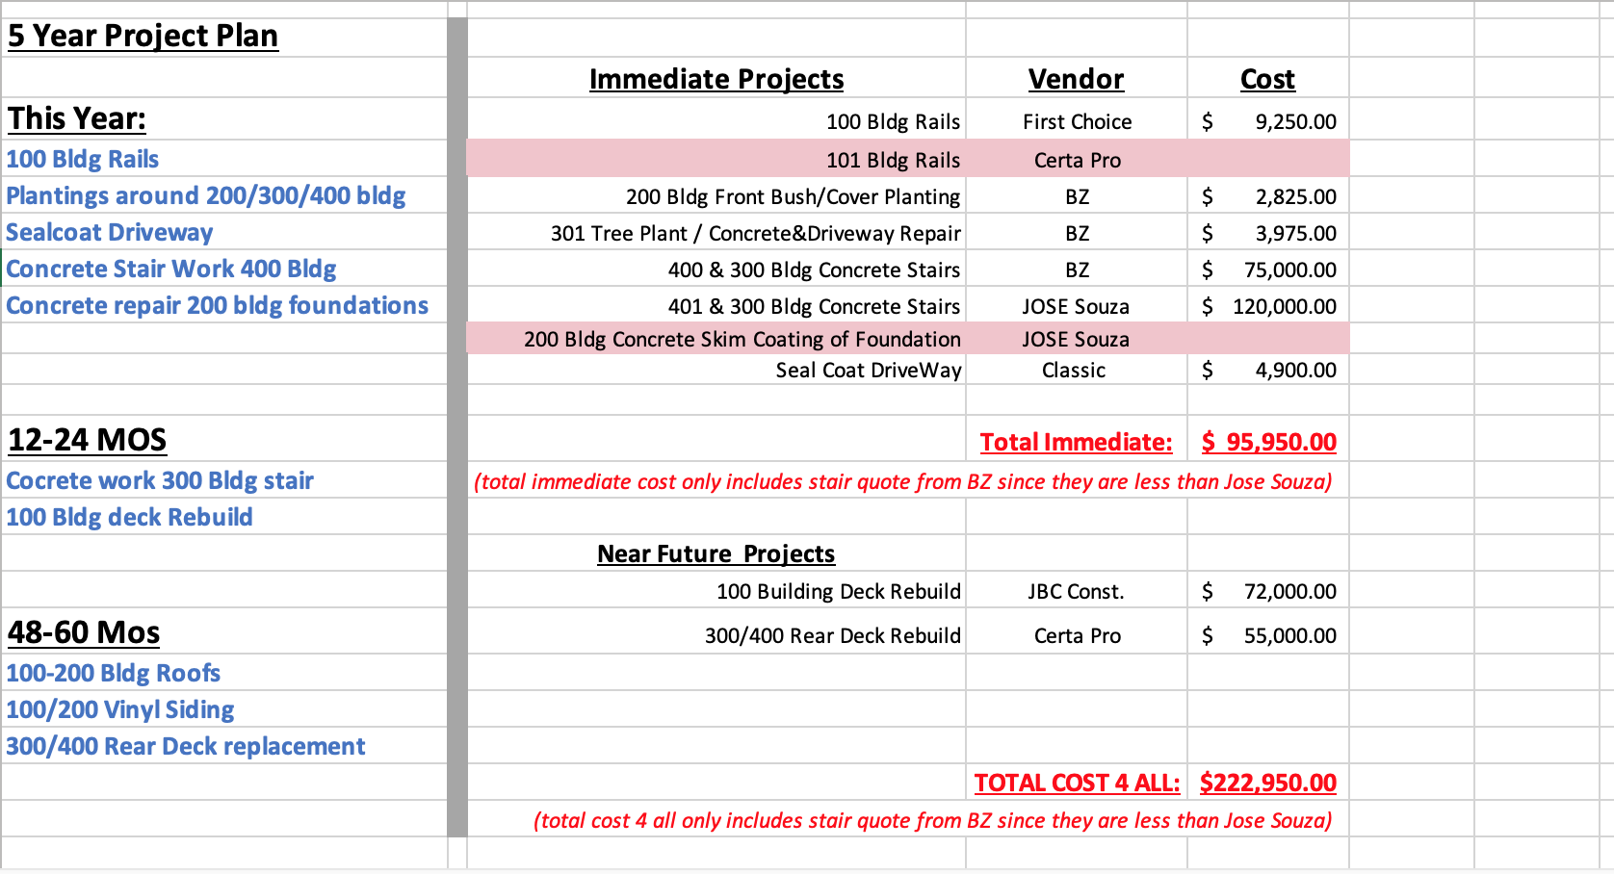
5 Year Plan:

Slide 3
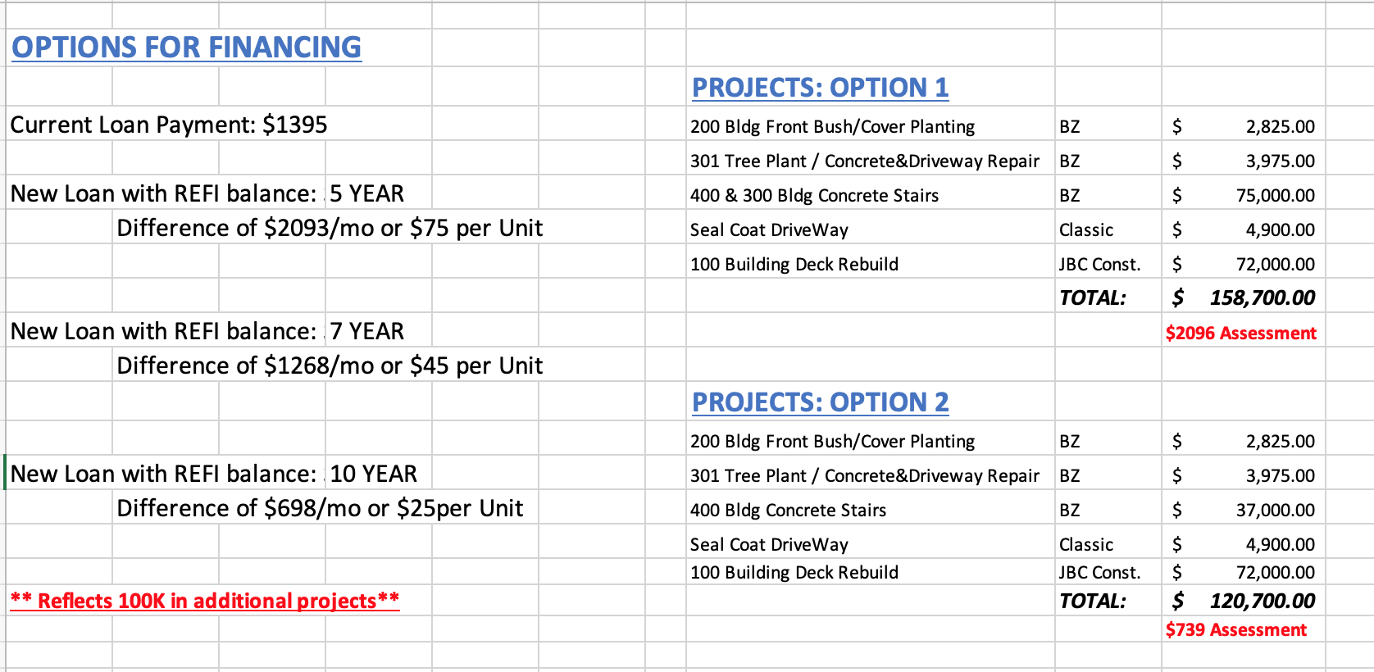

Slide 4
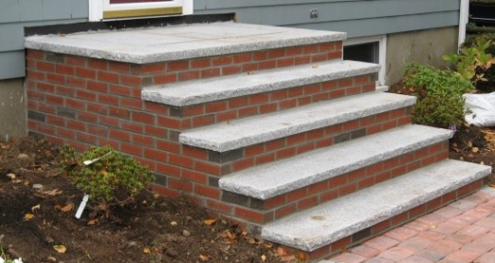
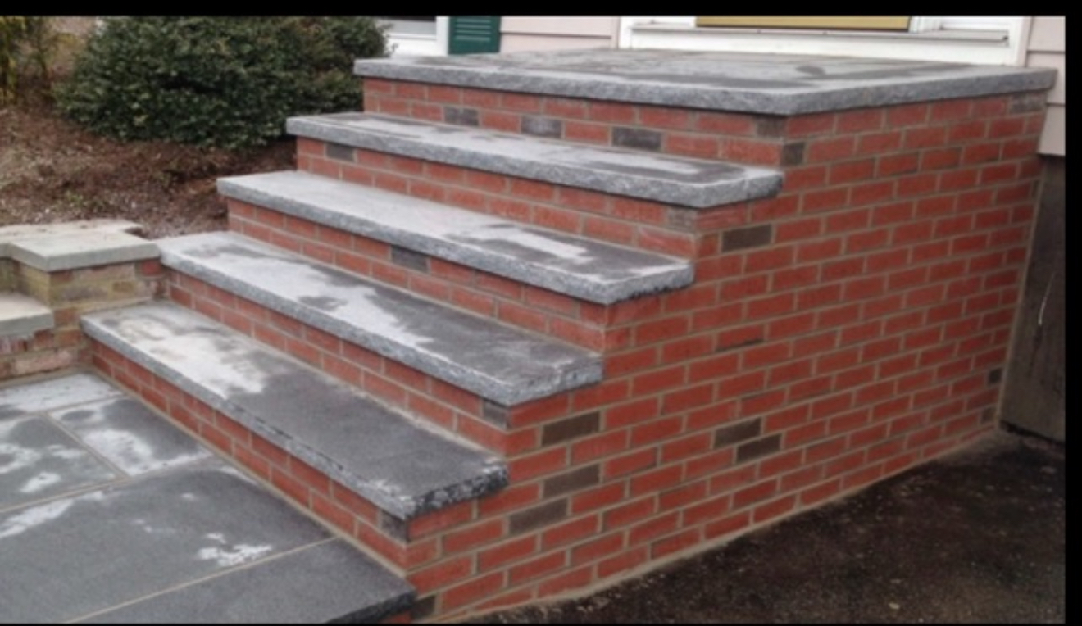
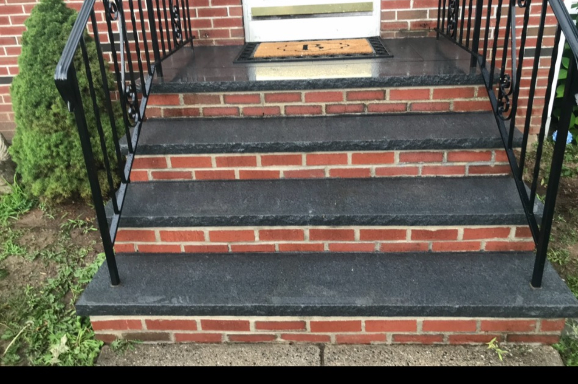
Examples Of Project:

